Slide 1
Node.js for Architects
Oscar Renalias, JavaSlava 2013

Slide 2





About me
@oscarrenalias
github.com/oscarrenalias
oscar.renalias@accenture.com
oscar@renalias.net

Slide 4
Server-side

Slide 5

Javascript
Dynamic
Weakly typed
Closures and functions
Objects and prototypes
Standardized as ECMAScript

Slide 6
Single threaded
Notes:
Unashamedly inspired by: http://www.slideshare.net/sergimansilla/big-app-design-for-nodejs (slide 11)

Slide 7
Event-based
Event
Event
Callbacks
Event
Loop
Event

Slide 8
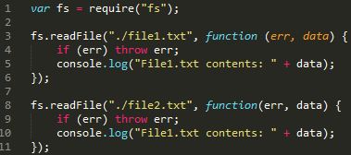
Callbacks

Slide 9
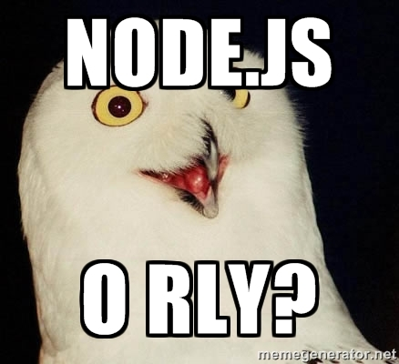

Slide 10
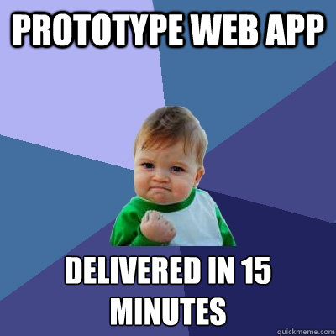
Rapid prototyping, rapid development

Slide 11
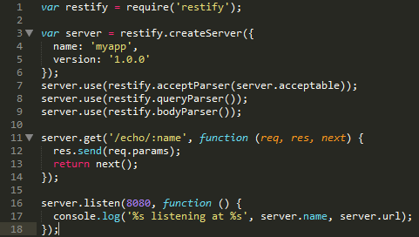
RESTful services with no effort
Notes:
Node-restify is used here, but it can all be accomplished without a framework too.

Slide 12
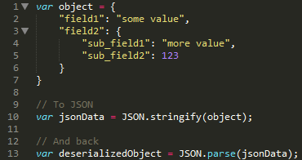
No-fuss, native JSON handling
Notes:
JSON is Javascript’s native serialization format
Integrates very well with things like JSON-based APIs, MongoDB, etc – things that speak JSON natively

Slide 13
Painless modules: CommonJS
var someModule = require(“…”);
Modules can expose a single top-level function or object
Can also expose multiple objects

Slide 14

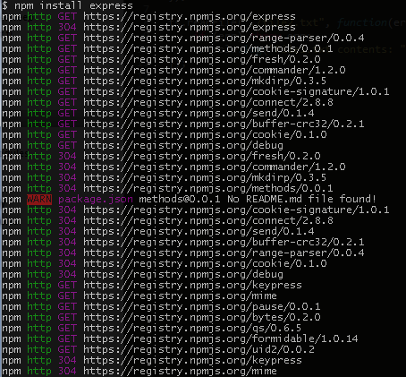
Awesome Package management
Gets out of the way
Support for internal and public modules
Kiss problems with transitive dependencies goodbye

Slide 15
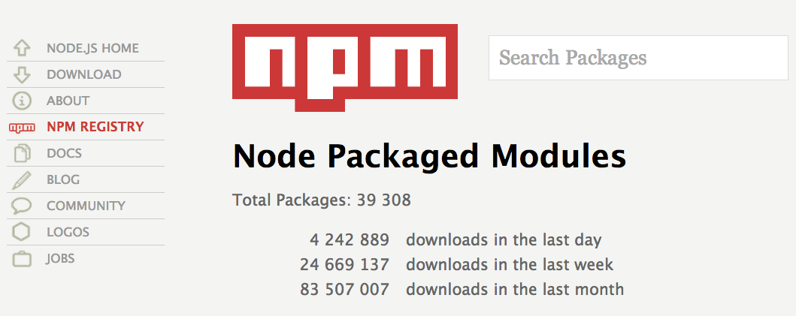
Community modules
http://npmjs.org

Slide 16
How
Mature and innovative frameworks

Slide 17
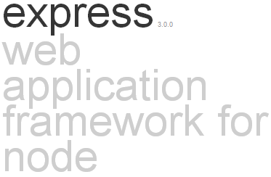
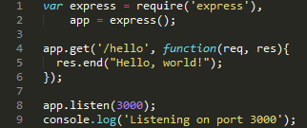
Express
Minimal web application framework
Additional features are provided as modules or middleware: template engines, models, authentication and authorization, etc

Slide 18
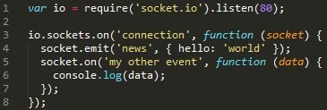
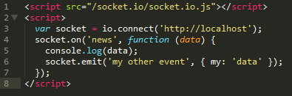
Socket.io
Provides support for server-initiated push events using WebSockets, Ajax polling, Iframe, JSONP or Flash-based channels
Transparent for both clients and servers
Can run standalone or integrated with Express
SERVER
CLIENT

Slide 19
Meteor
Next-gen framework for real-time collaborative web applications
Live page updates
Support for offline databases with subsequent synchronization
Notes:
http://www.meteor.com

Slide 20
When to use Node.js
REST+JSON APIs
Backend for single-page web apps
Real-time web apps with Socket.io and Meteor

Slide 21
When not to use Node.js
CPU-bound or multi-threaded applications
Boring CRUD-type web apps
Notes:
Node.js frameworks don’t make it neither easier nor more difficult to write traditional web apps; Node.js and its frameworks just simply make no difference here

Slide 22

Enterprise readiness?
Notes:
Image credit: http://www.allmystery.de/i/bk33NhA_ayZYgl_USS_Enterprise_NCC_1701_A_by_cb93.jpg

Slide 23
Maturity
Under development since 2008
Node.js 1.0 around the corner
39000 modules via npm
Awesome community
Commercial support
Notes:
https://groups.google.com/d/topic/nodejs/9afurRCTlOc/discussion

Slide 24
Does it scale?
Client
Load balancer
Load balancer
Load balancer
Node.js app
Node.js app
Node.js app
Node.js app
Node.js app
Node.js app
Notes:
Note: Diagram inspired from http://www.slideshare.net/BenLin2/webconf-nodejsproductionarchitecture
Node.js processes are single threaded so scalability within the same server is dependent on the number of node processes that we run.
In order to load balance the load within the same server, we can use a traditional load balancer running locally.
The next step is to scale multiple servers, for which we need an additional load balanced layer on top of the local instances.
Database/storage tier can be scaled according to the type of solution in use.

Slide 25
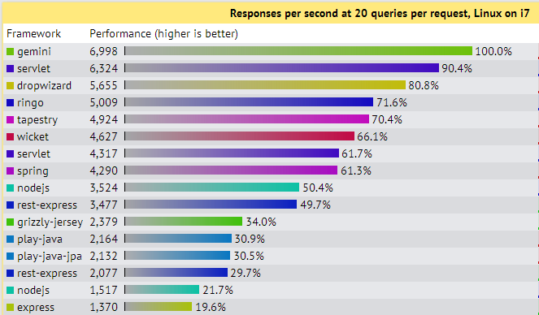
Performance
Source: http://www.techempower.com/benchmarks/

Slide 26
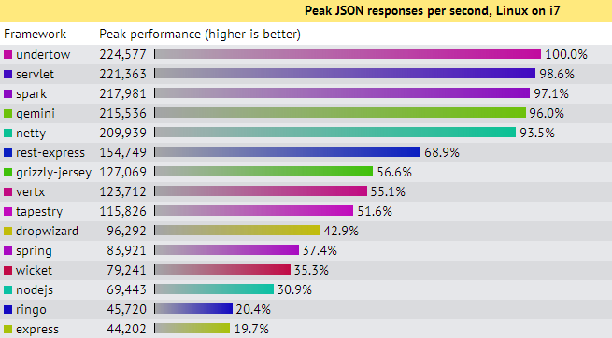
More Performance
Source: http://www.techempower.com/benchmarks/

Slide 27
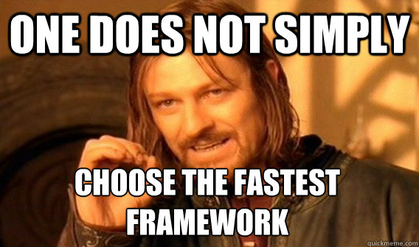
Not the fastest; does it always matter?

Slide 28

Javascript
Like Java, with easier syntax and no types
Weird shit
Notes:
Image source: http://drtom.ch/talks/2012/06/jazoon/images/tip_of_the_iceberg.jpg
Original idea: https://speakerdeck.com/anguscroll/the-politics-of-javascript

Slide 29
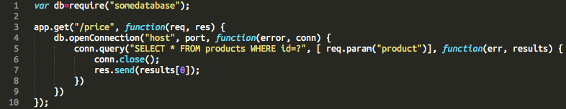
Spaghetti callback
Promises (Q, Q-IO)
ECMAScript 6, yield/continuations

Slide 30


Solid development toolset
Notes:
Grunt = Ant
Yeoman = Maven, some parts of it including archetypes (“generators” in Yeomanese)

Slide 31
Toolset
Large selection of testing libraries: unit testing, functional testing, BDD
Integration with Jenkins/Hudson
IntelliJ IDEA integration, Eclipse (Nodeclipse): highlighting, refactoring, debugging

Slide 32
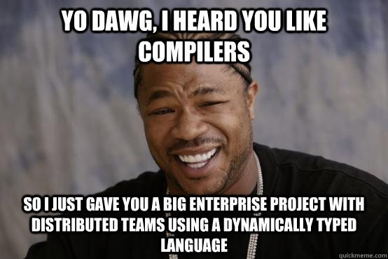
Big teams, big codebases
Extra effort and care must be paid to development lifecycle and code quality
Notes:
There is no substitute for a compiler
No proven success of Node.js applications in the enterprise world, yet

Slide 33






PaaS Support

Slide 34
Is it commercially supported?
Joyent is the corporate steward of Node.js, the world’s best runtime for today's data-intensive, real-time applications. Joyent offers exclusive debugging and performance analysis tools for Node.js applications.

Slide 35




Anybody using it?

